Slide 1

CPE 431/531 Chapter 6 – Parallel Processors from Client to Cloud
Dr. Rhonda Kay Gaede

Slide 2
6.1 Motivation
Why multiprocessors?
____________________
____________________
____________________

Slide 3
6.2 The Difficulty of Creating Parallel Programs
The difficulty with parallelism is not the _________, it’s the ________.
Why is it difficult to write parallel processing programs that are fast?
____________
____ ___________
___________ ____
____________ _________
________ ___

Slide 4
6.2 Speedup Challenge
Suppose you want to achieve a speedup of 90 times faster with 100 processors. What percentage of the original computation can be sequential?

Slide 5
6.2 Speedup Challenge – Bigger Problem
Suppose you want to perform two sums: one is a sum of 10 scalar variables and one is a matrix sum of a pair of two-dimensional arrays, size 10 by 10. What speedup do you get with 10 versus 40 processors?

Slide 6
6.2 Speedup Challenge – Bigger Problem
Next, calculate the speed-ups assuming the matrices grow to 20 by 20
Strong scaling
Weak scaling

Slide 7
6.2 Speedup Challenge: Balancing Load
To achieve the speed-up of 20.5 on the previous larger problem with 40 processors, we assumed the load was perfectly balanced (each processor did 2.5 % of the work). Instead, show the impact on speed-up if one processor’s load is higher than all the rest. Calculate at 5% and 12.5%.

Slide 8
6.3 SISD, MIMD, SIMD, SPMD, and Vector
SISD is the normal case – single instruction, single data.
MIMD – multiple instruction, multiple data - is ____________ possible but programmers normally write a ______ _______ that runs on all processors relying on ___________ statements when ________ processors should execute ________ sections of code. This style is single ________, multiple data.
SIMD – single instruction, multiple data – operate on ______ of data. SIMD needs only ___ ____ of the code that is being simultaneously executed. SIMD works best when dealing with _______ in ___ loops. _____ _______ ___________
The _____ _________ that inspired the SIMD category faded into history but two _______ interpretations of SIMD remain ______ today.
________________________
________

Slide 9
6.3 x86 Multimedia Extensions
The most _______ used variation of SIMD is the basis of the hundreds of MMX and SSE instructions of the x86 processor. These instructions were added to improve performance of _________ programs.
The hardware allows flexible ALU operations – one 64-bit or two 32-bit or for 16-bit or eight 8-bit
Loads and stores are simply as wide as the widest ALU.
SSE now supports simultaneous execution of a pair of 64-bit floating-point numbers

Slide 10
6.3 Vector
An older and more elegant interpretation of SIMD is called a vector architecture, which has been closely identified with Cray Computers.
Consider Y = a × X + Y
Original
l.d $f0,a($sp)
addiu $t1,$s0,#512
loop: l.d $f2,0($s0)
mul.d $f2,$f2,$f0
l.d $f4,0($s1)
add.d $f4,$f4,$f2
s.d $f4,0($s1)
addiu $s0,$s1,#8
addiu $s1,$s1,#8
subu $t0,$t1,$s0
bne $t0,$zero,loop
Vector
l.d $f0, a($sp)
lv $v1,0($s0)
mulvs.d $v2,$v1,$f0
lv $v3,0($s1)
addv.d $v4,$v4,$v3
sv $v4,0($s1)
Notes:
Execute only 6 instructions instead of 600
No hazards, in original each mul.d must wait for a l.d

Slide 11
6.3 Comparisons
Vector versus Scalar
A ______ _____ instruction specifies a great deal of work, the instruction ____ and _______ bandwidth is greatly reduced.
Hardware does not have to check for ____ _______ _____ a vector instruction.
Vector architectures and compilers have worked well for _________ ___________.
Hardware need only check for _____ hazards _____ between two vector __________, not ____ for every ______ _______.
Vector instructions that access memory have a _____ ______ _______, memory system can be adjusted accordingly.
Replacing a ____ with a ______ _______ reduces _____ hazards.
Vector versus Multimedia Extensions
Vector specifies the number of operands in _______, not in ________.
Vector data transfers need ___ be ________.
Vector _______ over time more _________.
Notes:
The data transfers need not be contiguous, the addresses are kept in a vector register. Indexed loads gather elements from main memory into contiguous vector elements and indexed stores scatter vector elements across main memory.

Slide 12
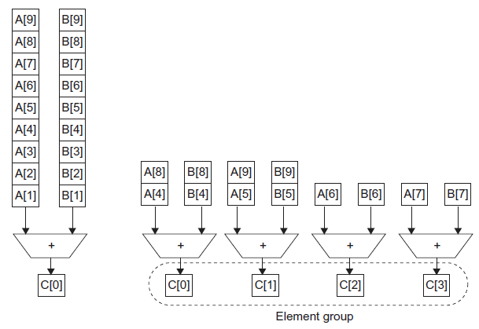
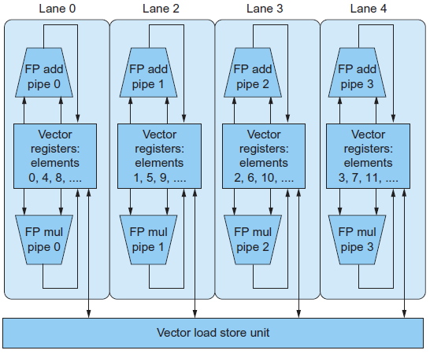
6.3 Improving the Performance of Vector

Slide 13
6.4 Hardware Multithreading
Hardware multithreading allows ________ ______ to ______ the ___________ units of a single processor in ___________ fashion.
The processor must __________ the independent _____ of each ______.
The hardware must support the ______ to _____ to different _______ relatively quickly.
____________ multithreading switches between _______ on each _________, often done round robin.
Hides __________ losses by doing useful work during ______ _____.
Inserts ________ for threads with __ ______.
____________ multithreading __________ threads only on ______ stalls, such as ____________ ______ misses.
It is limited in its ability to overcome ___________ losses, especially from _______ stalls. The major problem is pipeline ___ _____.

Slide 14
6.4 Simultaneous Multithreading
Simultaneous multithreading uses the resources of a _____________, ___________ scheduled processor to exploit ____________ parallelism at the same time it exploits ________________ parallelism.
The key insight is that multiple-issue processors often have more _________ ____ _____________ than a ______ thread can effectively use.
__________ of dependences can be handled by the _______ __________ capability.

Slide 15
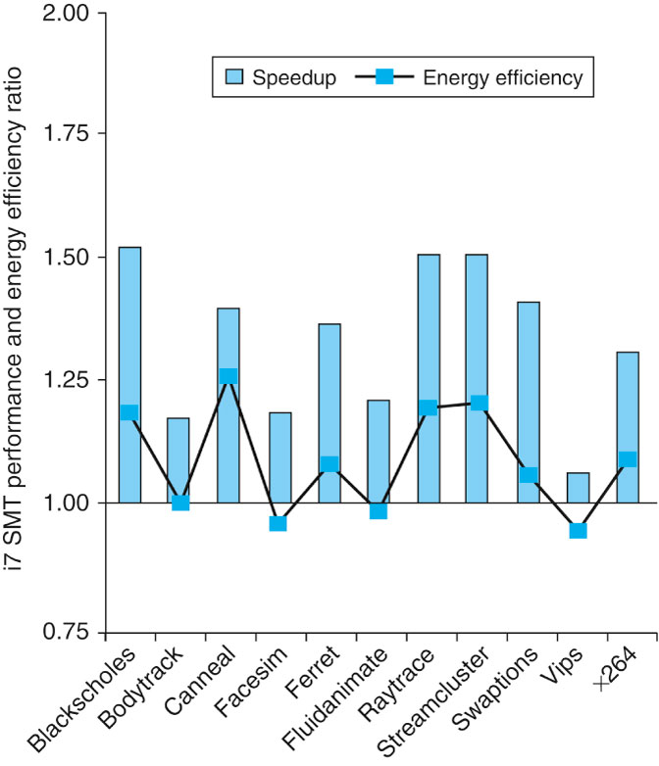
6.4 Multithreading Speedup
FIGURE 6.6 The speed-up from using multithreading on one core on an i7 processor averages 1.31 for the PARSEC benchmarks (see Section 6.9) and the energy efficiency improvement is 1.07. This data was collected and analyzed by Esmaeilzadeh et. al. [2011].

Slide 16
6.5 Multicore and Other Shared Memory Multiprocessors
A shared memory multiprocessor (SMP) is one that offers the programmer a _____ ________ ______ _____ across all processors
Processor communicate through ______ __________ in memory.
SMPs come in two flavors
______
______
Processors need to coordinate when sharing data, this process is called ______________, processors must acquire a _____

Slide 17
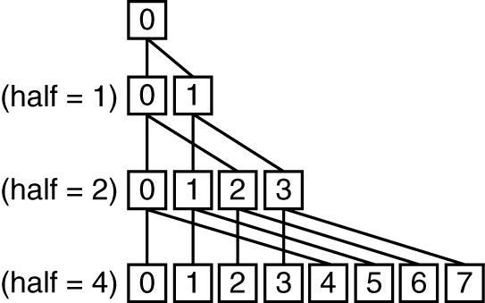
6.5 Shared Address Space Parallel Program (1)
Suppose we want to sum 64,000 numbers on an SMP with UMA. Let’s assume we have 64 processors.
sum[Pn] = 0;
for (i = 1000*Pn; i < 1000*(Pn+1); i = i + 1)
sum[Pn] = sum[Pn] + A[i]; /* sum the assigned areas */
After execution of this code, there are 64 partial sums
Need to combine them into single sum
Do so using a reduction
Notes:
Synchronization required at each step of reduction.

Slide 18
6.5 Shared Address Space Parallel Program (2)
half = 64; /* 64 processors in multiprocessor */
repeat
synch(); /* wait for partial sum completion */
if (half%2 != 0 && Pn == 0)
sum[0] = sum[0] + sum[half-1];
/* Conditional sum needed when half is odd;
Processor0 gets missing element */
half = half/2; /* dividing line on who sums */
if (Pn < half) sum[Pn] = sum[Pn] + sum[Pn+ half];
until (half == 1); /* exit with final sum in sum[0] */

Slide 19
6.5 A Parallel Programming System
A limited but popular example is OpenMP
OpenMP is an Application Programmer Interface along with a set of compiler directives, environment variables, and runtime library routines.
It offers a portable, scalable,and simple programming model for shared memory multiprocessors.
Its primary goal is to parallelize loops and to perform reductions.
OpenMP extends C using pragmas, commands to the C macro processor
Minimum distance = _3_ provides _single_ error correction, double__ error detection

Slide 20
6.5 OpenMP Example
Cc –fopenmp foo.c
#define P 64 /* define a constant */
#pragma omp parallel num_threads(P)
#pragma omp parallel for
for (Pn = 0; Pn < P; Pn +=1)
for (1000*Pn; i < 1000*(Pn +1); i +=1)
sum[Pn] += A[i]; /* sum the assigned areas */
#pragma omp parallel for reduction(+ : FinalSum)
for (i = 0; i < P; i += 1)
FinalSum += sum[i]; /* Reduce to asingle number */

Slide 21
6.6 Introduction to Graphics Processing Units
A major driving force for improving graphics processing was the gaming industry, a different development community than the one for CPUs.
Key differences between GPUs and CPUs
GPUs are accelerators that supplement a CPU, they don’t have to do everything.
GPU problems sizes are typically hundreds of megabytes to gigabytes, but not hundreds of gigabytes to terabytes.
Different Architecture Features
GPUs do not rely on multilevel caches, they rely on having enough threads to hide memory latency.
The GPU main memory is oriented towards bandwidth rather than latency.
Each GPU processor is more highly multithreaded than a typical CPU, plus they have more processors.
A major driving force for improving graphics processing was the _______ _______, a different ____________ _________ than the one for CPUs.
GPUs are ___________ that __________ a CPU, they don’t have to do ___________.
The programming __________ to GPUs are high-level __________ _____________ interfaces (APIs), such as OpenGL, coupled with high-level graphics _______ _________. Freedom from backward binary ___________ ____________ leads to _____ _________.
Graphics processing involves drawing _________ and rendering ______.
_________ and ___________ can be done ___________, data-level parallelism.
GPUs do not rely on _________ caches, they rely on having enough _______ to ____ memory latency.
GPUs rely on extensive parallelism to obtain high performance, implementing many _________ __________ and many _________ ________.
The GPU main memory is oriented towards ________ rather than _______.

Slide 22
6.6 Programming GPUs
Initially programmers only had graphics APIs and languages.
They developed C-inspired programming languages
NVIDIA Compute Unified Device Architecture (CUDA)
OpenCL is a multi-company initiative to develop a portable programming language
Unifying theme is CUDA thread
Compiler and hardware can gang thousands of CUDA threads together to utilize multithreading, MIMD, SIMD, and instruction-level parallelism
Threads are blocked together and executed in groups of 32 at a time
A multithreaded processor inside a GPU executes these blocks of threads, and a GPU consists of 8 to 32 of these multithreaded processors.
A major driving force for improving graphics processing was the _______ _______, a different ____________ _________ than the one for CPUs.
GPUs are ___________ that __________ a CPU, they don’t have to do ___________.
The programming __________ to GPUs are high-level __________ _____________ interfaces (APIs), such as OpenGL, coupled with high-level graphics _______ _________. Freedom from backward binary ___________ ____________ leads to _____ _________.
Graphics processing involves drawing _________ and rendering ______.
_________ and ___________ can be done ___________, data-level parallelism.
GPUs do not rely on _________ caches, they rely on having enough _______ to ____ memory latency.
GPUs rely on extensive parallelism to obtain high performance, implementing many _________ __________ and many _________ ________.
The GPU main memory is oriented towards ________ rather than _______.

Slide 23
6.6 Introduction to Graphics Processing Units
Cc –fopenmp foo.c
#define P 64 /* define a constant */
#pragma omp parallel num_threads(P)
#pragma omp parallel for
for (Pn = 0; Pn < P; Pn +=1)
for (1000*Pn; i < 1000*(Pn +1); i +=1)
sum[Pn] += A[i]; /* sum the assigned areas */
#pragma omp parallel for reduction(+ : FinalSum)
for (i = 0; i < P; i += 1)
FinalSum += sum[i]; /* Reduce to asingle number */

